Slide 1
Keyboard Finger Position Display
Techblazers

Slide 2

What is this guy’s problem?

Slide 3



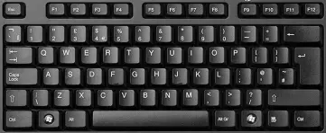
Problem:
Non-Touch Typers
Visually Impaired
May contribute to bad posture or neck strain
Wastes time
Keys not easily seen due to font size and color

Slide 4

How can we solve this problem?

Slide 5
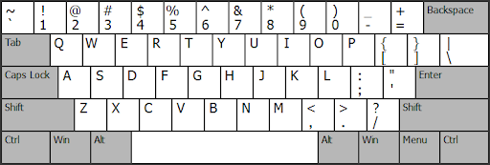

Solution: Keyboard Finger Position Detector and Display (KFPDD)
Enables the visually impaired to see which keyboard keys are being touched without them needing to look down at the keyboard.
This device senses what key has been touched through capacitive touch sensing and displays the touched key to the on-screen keyboard on the user’s computer
The onscreen keyboard will be accessed through an app
The user will be able to adjust the font type, size, and background color settings for the onscreen keyboard for better visibility

Slide 6
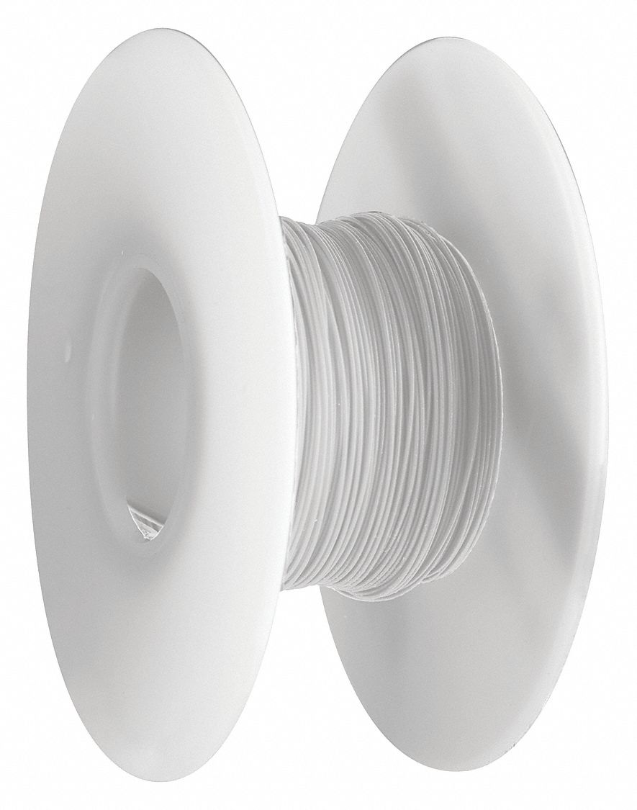
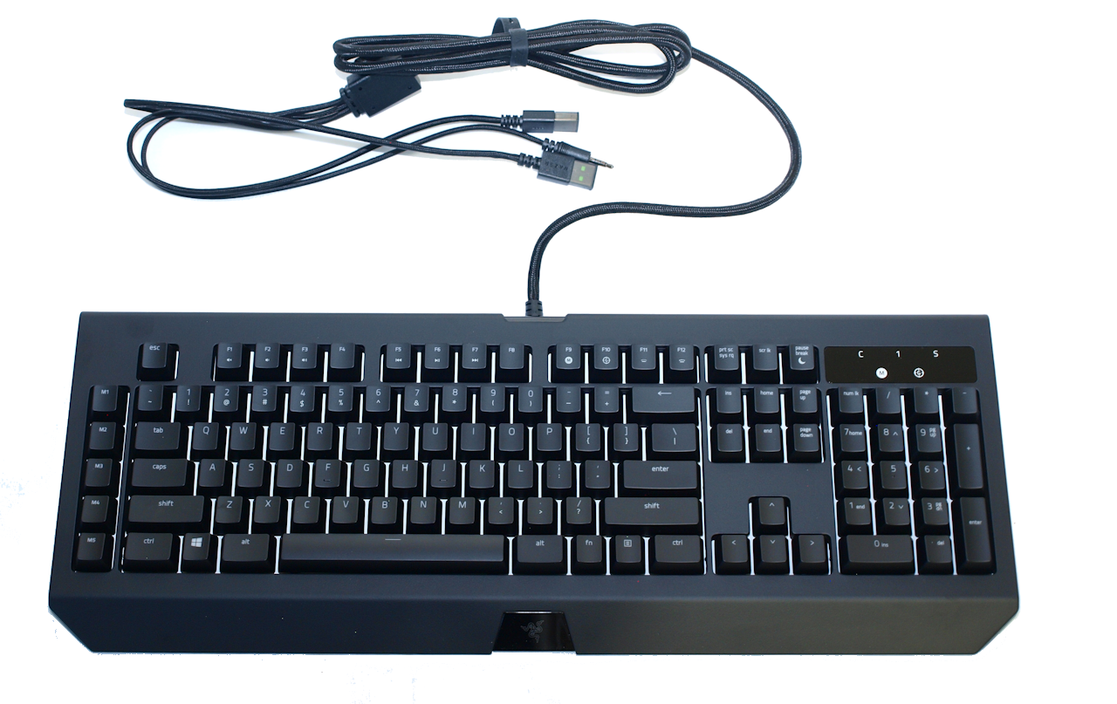
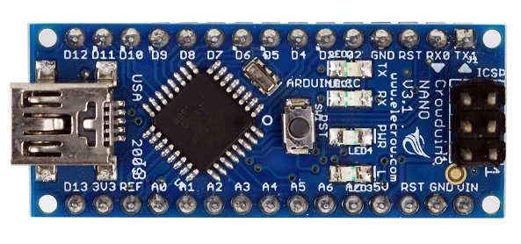
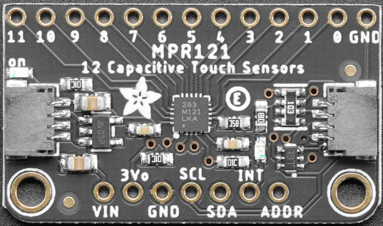
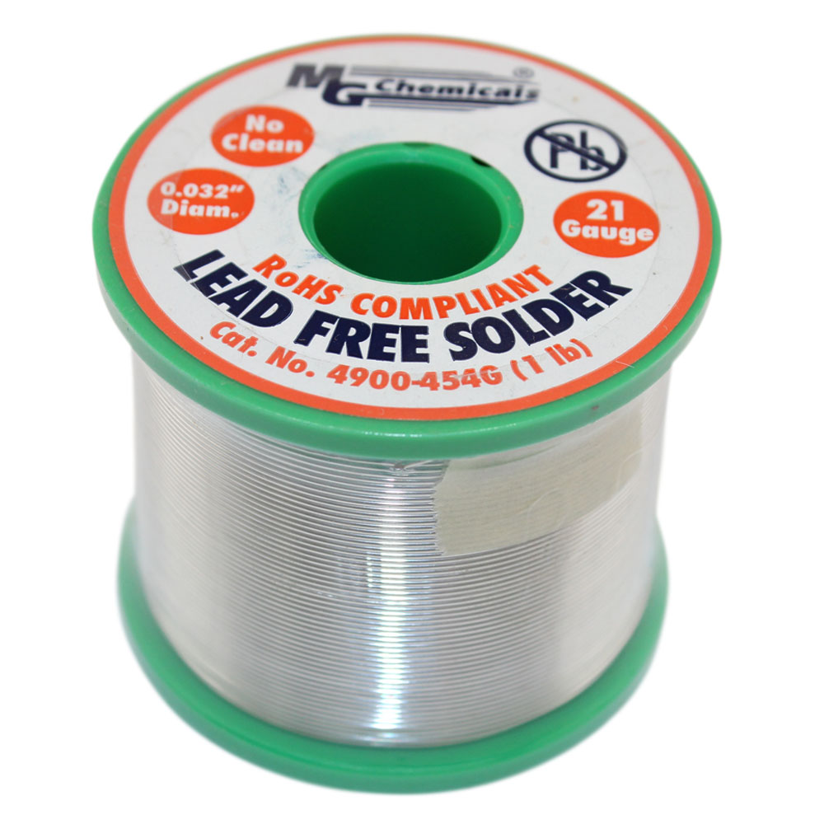
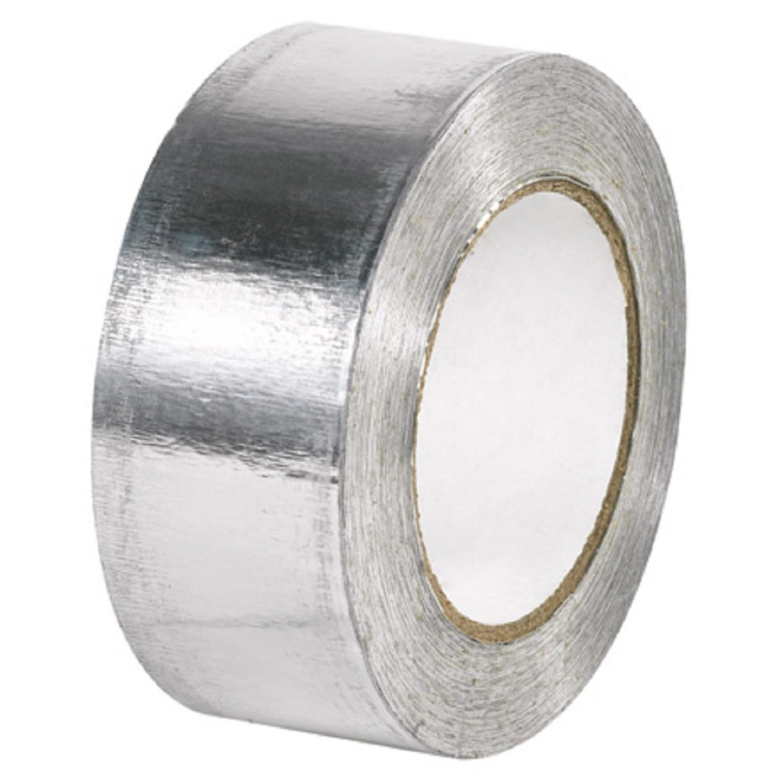
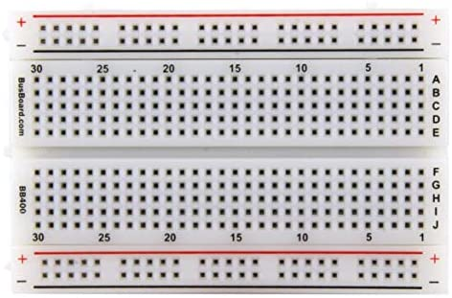
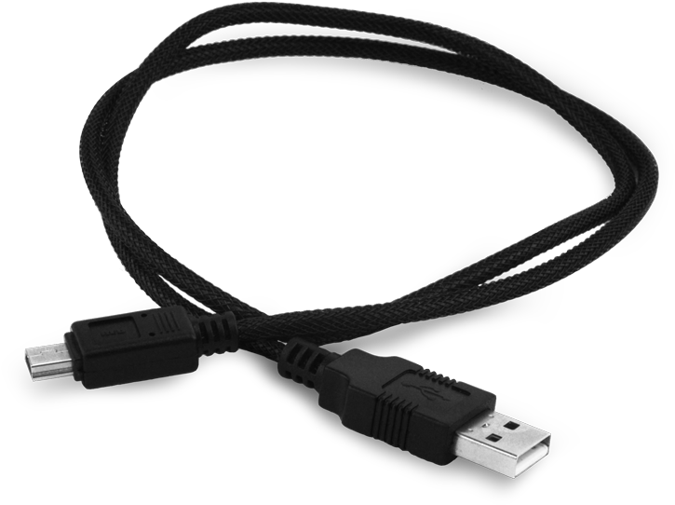
Prototype Hardware Materials
Razer Blackwidow Chroma Keyboard
2x MPR121 12-Key Capacitive Touch Sensors
Arduino Nano
28 AWG Stranded Core Wire
Aluminum Foil Tape
BreadBoard
USB Interface
Solder

Slide 7
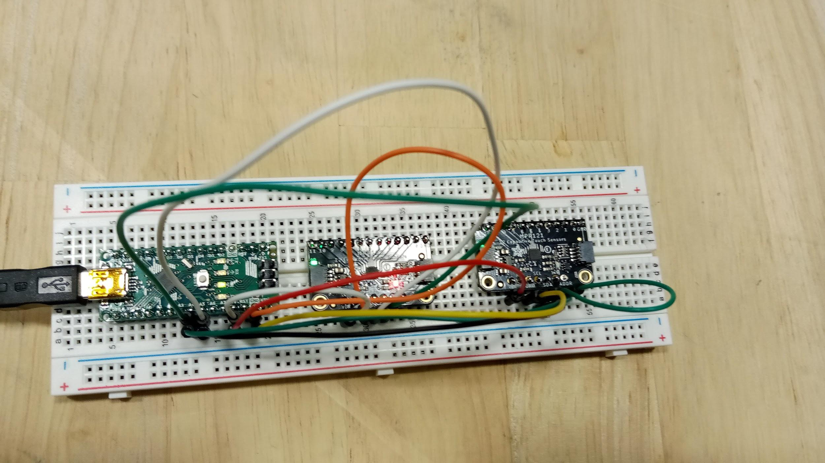
Prototype
Arduino Nano
Touch Pins
USB Out
Capacitive Sensors
Capacitive Touch Sensors Integration with Arduino Nano

Slide 8
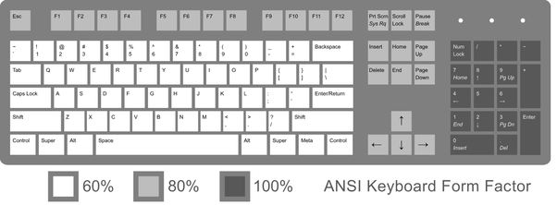
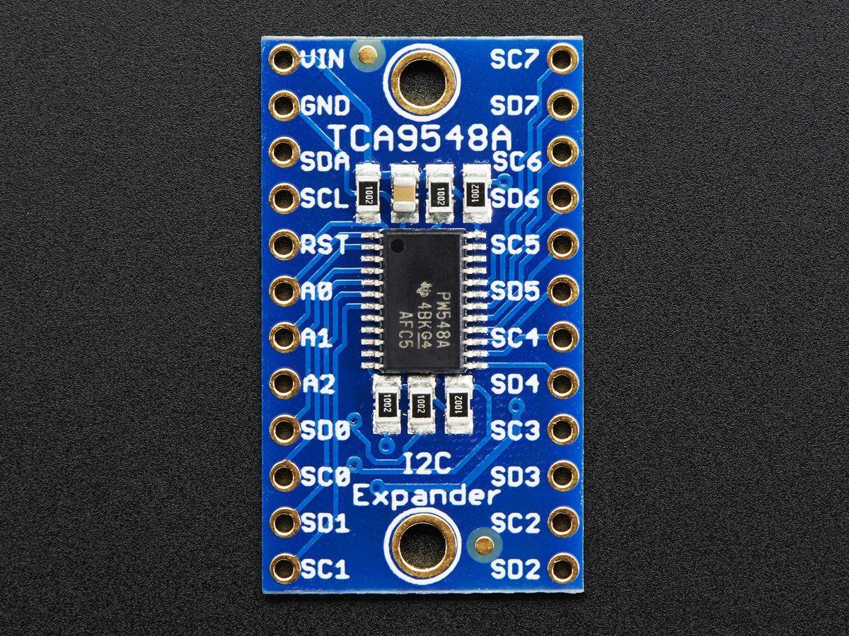
Status
Expand capacitive touch sensing to 60% of the keyboard with a multiplexer
Multiplexer will allow additional capacitive touch sensors to be utilized
Use proximity sensing to detect a touch on a key
Normal non-conductive keys
Add features to the of onscreen keyboard
Transparency, font, color, etc
Multiplexer

